Slide 1
Cybersecurity
Watering Hole Attacks

Slide 2
Watering Hole Attack
Instead of laboring over ways to attack a target network, what if they come to you?
Go where they go
Organizations usually visit certain websites routinely
Either vendors, reference information, or Software as a Service (SaaS) sites
Ever a URL incorrectly?
What you meant: google.com
What you typed: gogle.com or gooogle.com or ggle.com
Google knows people will make mistakes and have registered the first two. That third one is not owned by Google!

Slide 3
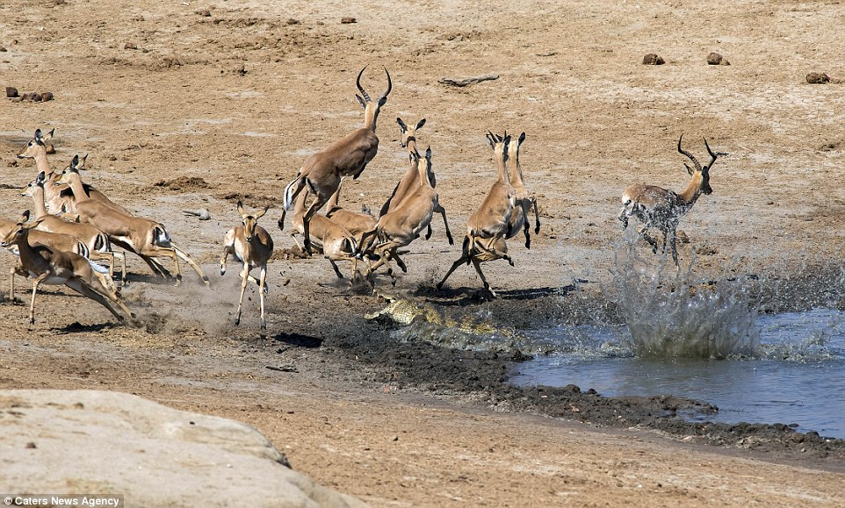
Watering Hole Attack
Setup official-looking website but loaded with malicious code -or- infect actual site the targets frequent
Wait for them to come to you!

Slide 4
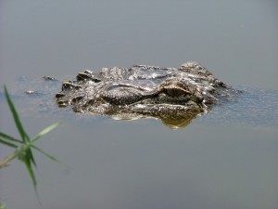
Executing the Watering Hole Attack
Determine sites the target frequents
Educated guess
Industry-related sites
Infect a third-party site
Exploit vulnerability on web server
Send malicious email attachments
All visitors to the site get hit
Filter for specific victims

Slide 5

Defending from a Watering Hole
Defense-in-depth
Layered defense
Never just one thing
Firewalls and IPS
Stop bad network traffic
Keep Anti-virus & Anti-malware updated
Always update

